Slide 1
Uncovering Modern Policing Talent
(RCMP)
Team: 2097
Jingrui Mu, Yi Luo, Yi Li, Bing Wang

Slide 2
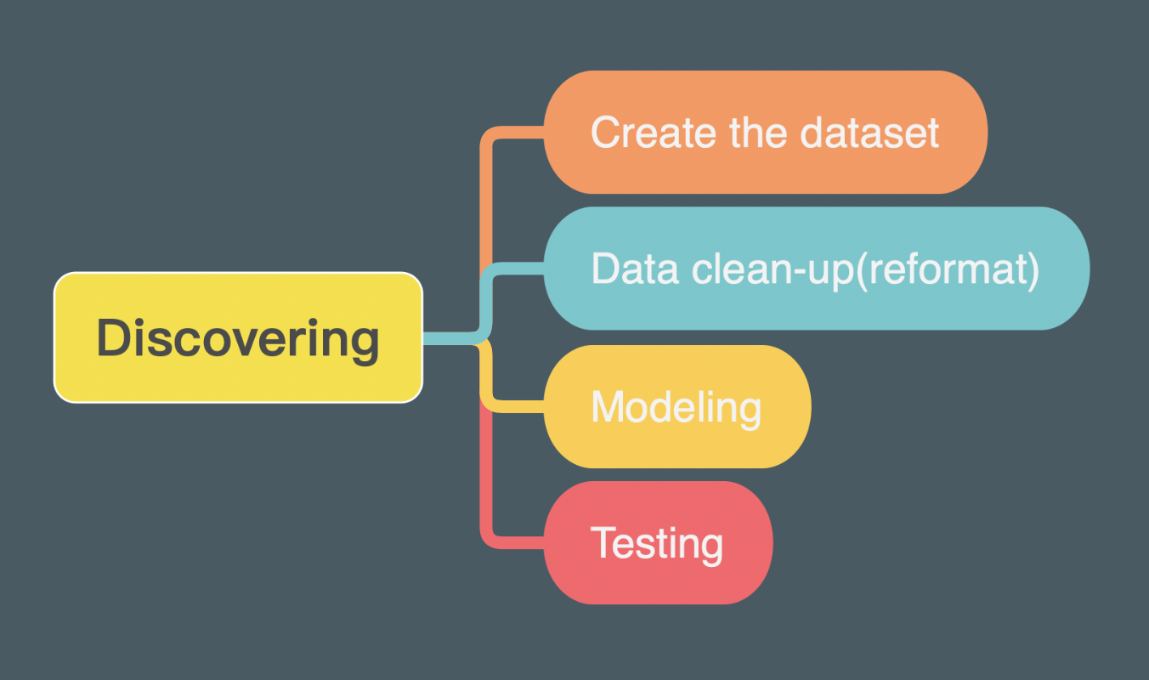

Slide 3
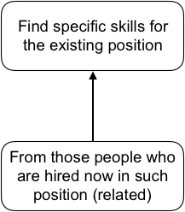

Slide 4
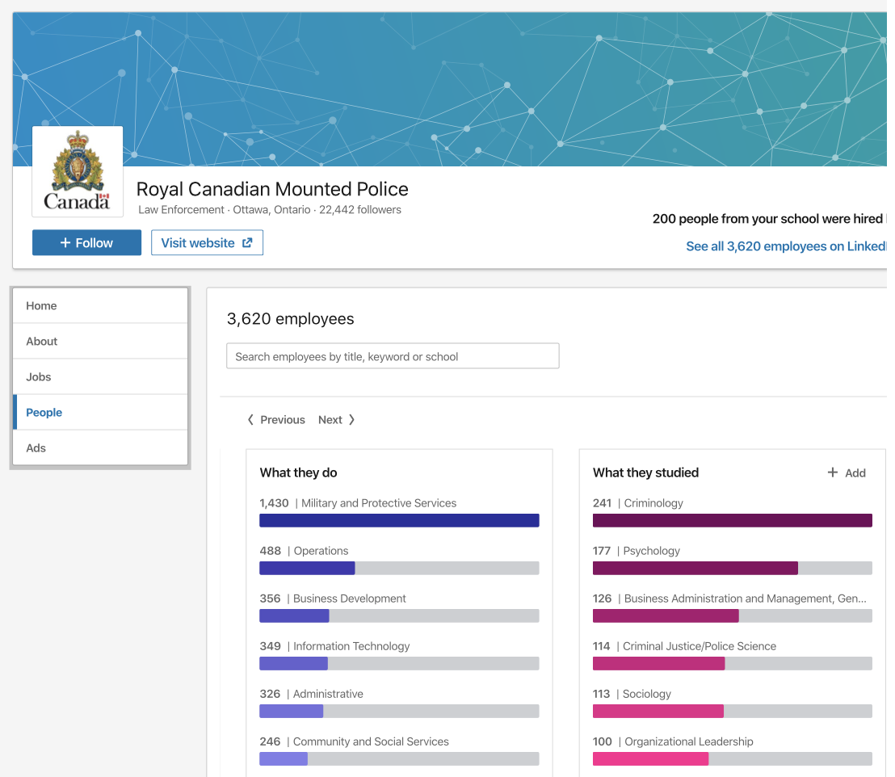
Data mining!
@https://www.linkedin.com/company/rcmp-grc/people/

Slide 5
The information we can get from the hired people
No. | Sex | Proficiency of Language | Education degree | Programs of Education | Number of Education Degrees | Licenses & Certifications | Numbers of Work Experience | Endorsements | Extracurricular Activities | Skills | Competences | Honors & Awards | Y/N
1 | 1 | 2 | 2 | 6,7 | 2 | 1 | 0 | 0 | 0 | 1,2,3,4,5,9 | 1,2,3,4,6,7 | 2 | 1
2 | 1 | 2 | 2 | 2 | 1 | 0 | 4 | 7 | 0 | 3,4,9 | 2,3 | 0 | 1
3 | 1 | 3 | 3 | 1,6 | 2 | 1 | 7 | 4 | 0 | 1,4,5 | 1,3 | 4 | 1
4 | 1 | 4 | 1 | 6,7 | 2 | 0 | 1 | 9 | 2 | 3 | 3,6 | 1 | 1
5 | 1 | 2 | 1 | 6 | 1 | 0 | 0 | 1 | 1 | 3,4 | 1,3 | 4 | 1
6 | 1 | 2 | 2 | 1 | 1 | 0 | 3 | 0 | 0 | 3,5,6,9 | 1,2,3 | 0 | 1
7 | 1 | 4 | 2 | 6 | 1 | 0 | 3 | 1 | 0 | 1,2,3,9 | 1,2,3,4 | 3 | 1
8 | 1 | 1 | 6 | 1 | 1 | 0 | 0 | 0 | 0 | 2,5,6,8,9 | 1,4 | 0 | 0
9 | 1 | 1 | 2 | 1 | 1 | 0 | 5 | 0 | 0 | 1,2,4,5 | 1,3 | 0 | 1
10 | 0 | 1 | 1 | 7 | 2 | 1 | 0 | 1 | 1 | 5,6,9 | 1,2,3 | 0 | 1
11 | 1 | 1 | 2 | 6 | 1 | 0 | 4 | 0 | 1 | 3,4,8 | 1,3 | 0 | 1
12 | 1 | 1 | 1 | 2 | 1 | 0 | 0 | 1 | 0 | 3,6,7 | 1,3,7 | 0 | 1
13 | 0 | 2 | 1 | 6 | 1 | 0 | 2 | 3 | 5 | 1,5,6 | 3 | 0 | 1
14 | 1 | 1 | 2 | 2 | 1 | 0 | 1 | 0 | 0 | 3,4,5,9 | 1,3 | 0 | 0
.
.
.

Slide 6
Description of variation
Sex
1.Male
2.Female
Proficiency of Language (Numerical)
Education degree
1.Cege
2.Bachelor
3.Master
4.Post-doc
Programs of Education
1.Faculty of Science
2.Faculty of Arts
3.Faculty of Engineering
4.Faculty of Medical Science
5.Faculty of Fine Arts
6.Faculty of Law
7.Faculty of Business
Number of Education Degrees (Numerical)
Licenses & Certifications (Numerical)
Numbers of Past Work Experience (Numerical)
Endorsements (Numerical)
Extracurricular Activities (Numerical)
Numbers of Skills
Skills
1.Communication
2.Tools & technology
3.Investigation & Analytics
4.Interrogation
5.Leadership
6.Strategic planning
7.Research
8.Public relations
9.Security operation
Competences
1.Knowledge of public policy, professions
2.Problem solving and critical analysis
3.Information management
4.Observation
5.Temperament and physical abilities
6.Interdiscipline
7.Financial affairs
Honors & Awards (Numerical)
Department (ie:..)

Slide 7
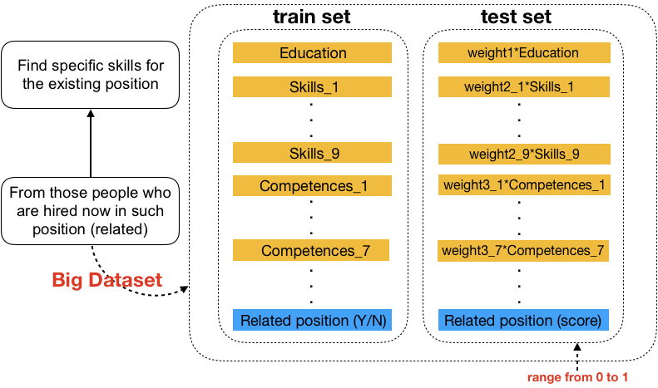

Slide 8
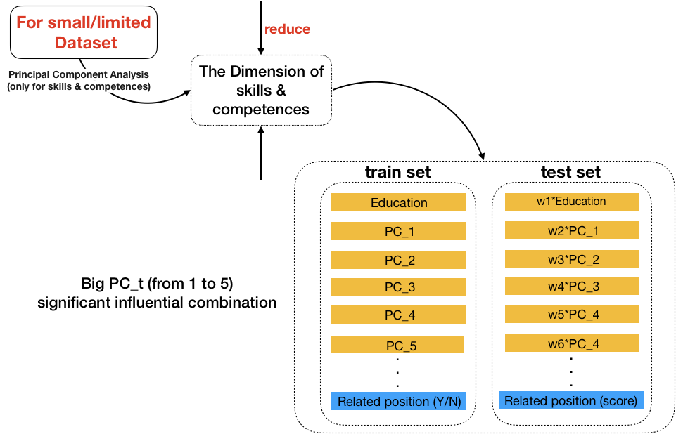

Slide 9
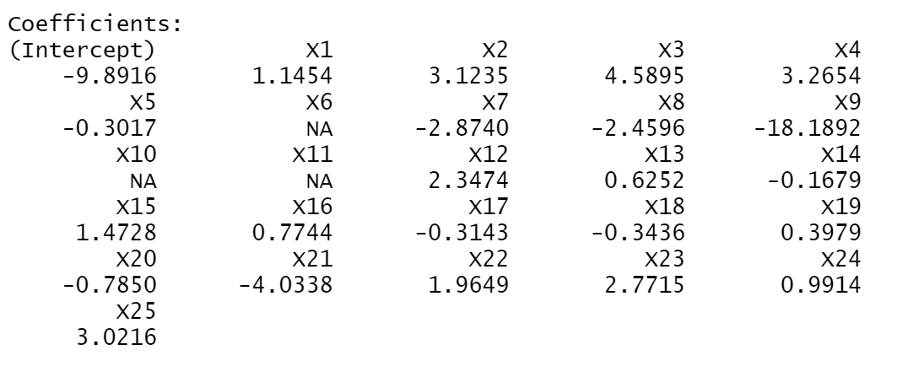
Language
Faculty of science
Result:
Tools & technology;
observation
Faculty of engineering

Slide 10
Thank you!

